Slide 1

Legal Resource Center for Public Health Policy
Blair Inniss
Deputy Director
November 8, 2023

Slide 2
Tribal Land Acknowledgment
We humbly acknowledge that we are convening on the ancestral lands of the Piscataway, Nentego (Nanticoke), and Susquehannock peoples in Baltimore City. We wish to pay our respects to the elders and past and present citizens of these tribes. We strive to hold space and value the perspectives that these nations share regarding their histories, cultures, and traditions.
We also acknowledge the land stolen from these nations, whether through colonization, broken treaties, forced removal and/or genocide and their inherent right to self-determination. May this digital space serve as one moment among many for ending anti-Black racism, modern colonialism, and white supremacy, and for creating equitable relations that honor and heal communities and the land.
information about tribal lands found at https://native-land.ca/

Slide 3
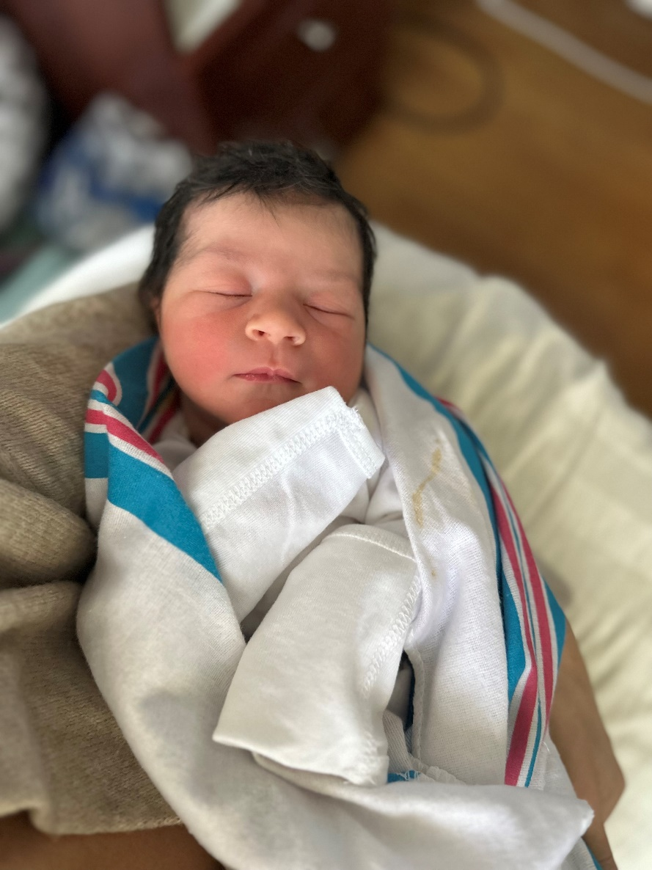
Welcome Lily Claire Torton!!!

Slide 4
Agenda
Federal Updates
Maryland Updates
Alcohol, Tobacco, and Cannabis Commission
Questions

Slide 5
Proposed Rules at White House
October 16 FDA sent two finalized rules to the Office of Management and Budget
  Tobacco Product Standard for Characterizing Flavors in Cigars [Docket No. FDA–2021–N–1309]
  Tobacco Product Standard for Menthol in Cigarettes [Docket No. FDA–2021–N–1349]
Next step → EO meetings

Slide 6
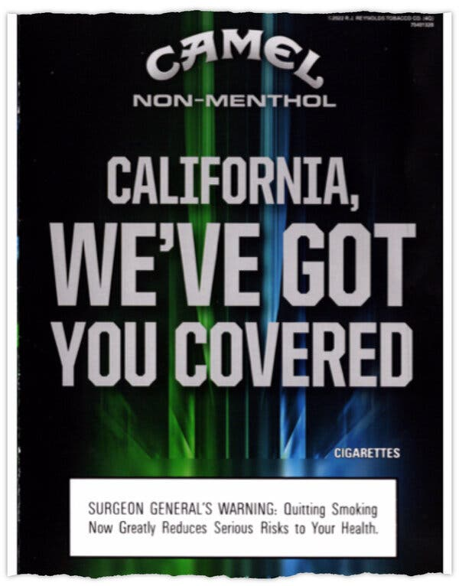
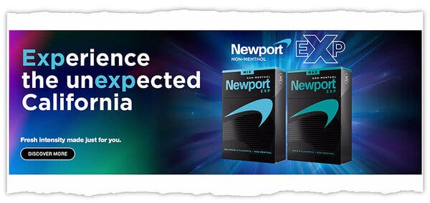
Non-menthol Menthol
Synthetic flavoring agent WS-3
Delivers similar, or stronger, cooling sensations as menthol but without the minty aroma or taste

Slide 7
Is WS-3 a characterizing flavor?
The presence and amount of artificial or natural flavor additives, compounds, constituents, or ingredients, or any other flavoring ingredient
The multisensory experience (i.e., taste, aroma, and cooling or burning sensations in the mouth and throat) of a flavor during use
Flavor representations (including descriptors), either explicit or implicit, in or on the labeling (including packaging) or advertising of tobacco products
Any other means that impart flavor or represent that the tobacco products has a characterizing flavor

Slide 8
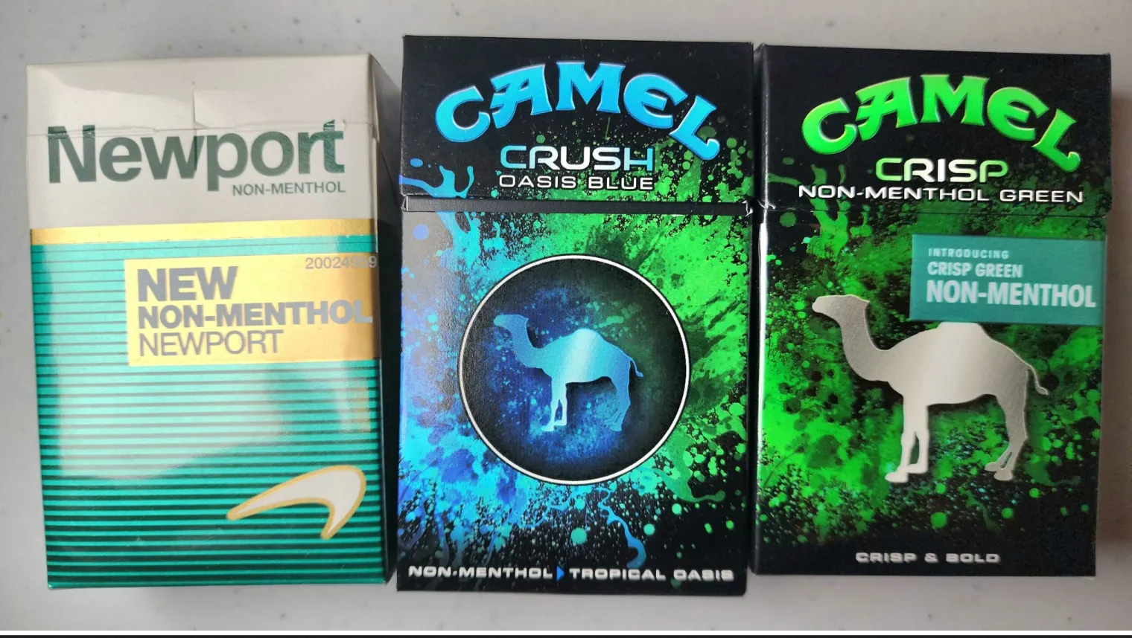
Is WS-3 a characterizing flavor?

Slide 9
Is WS-3 a characterizing flavor?
The presence and amount of artificial or natural flavor additives, compounds, constituents, or ingredients, or any other flavoring ingredient
The multisensory experience (i.e., taste, aroma, and cooling or burning sensations in the mouth and throat) of a flavor during use
Flavor representations (including descriptors), either explicit or implicit, in or on the labeling (including packaging) or advertising of tobacco products
Any other means that impart flavor or represent that the tobacco products has a characterizing flavor

Slide 10
Tobacco Product Violations
Report tobacco product violations to the FDA
https://www.fda.gov/tobacco-products/compliance-enforcement-training/report-potential-tobacco-product-violation
Call the Tobacco Call Center: 1.877.CTP.1373
Send an email: CTPCompliance@FDA.hhs.gov

Slide 11
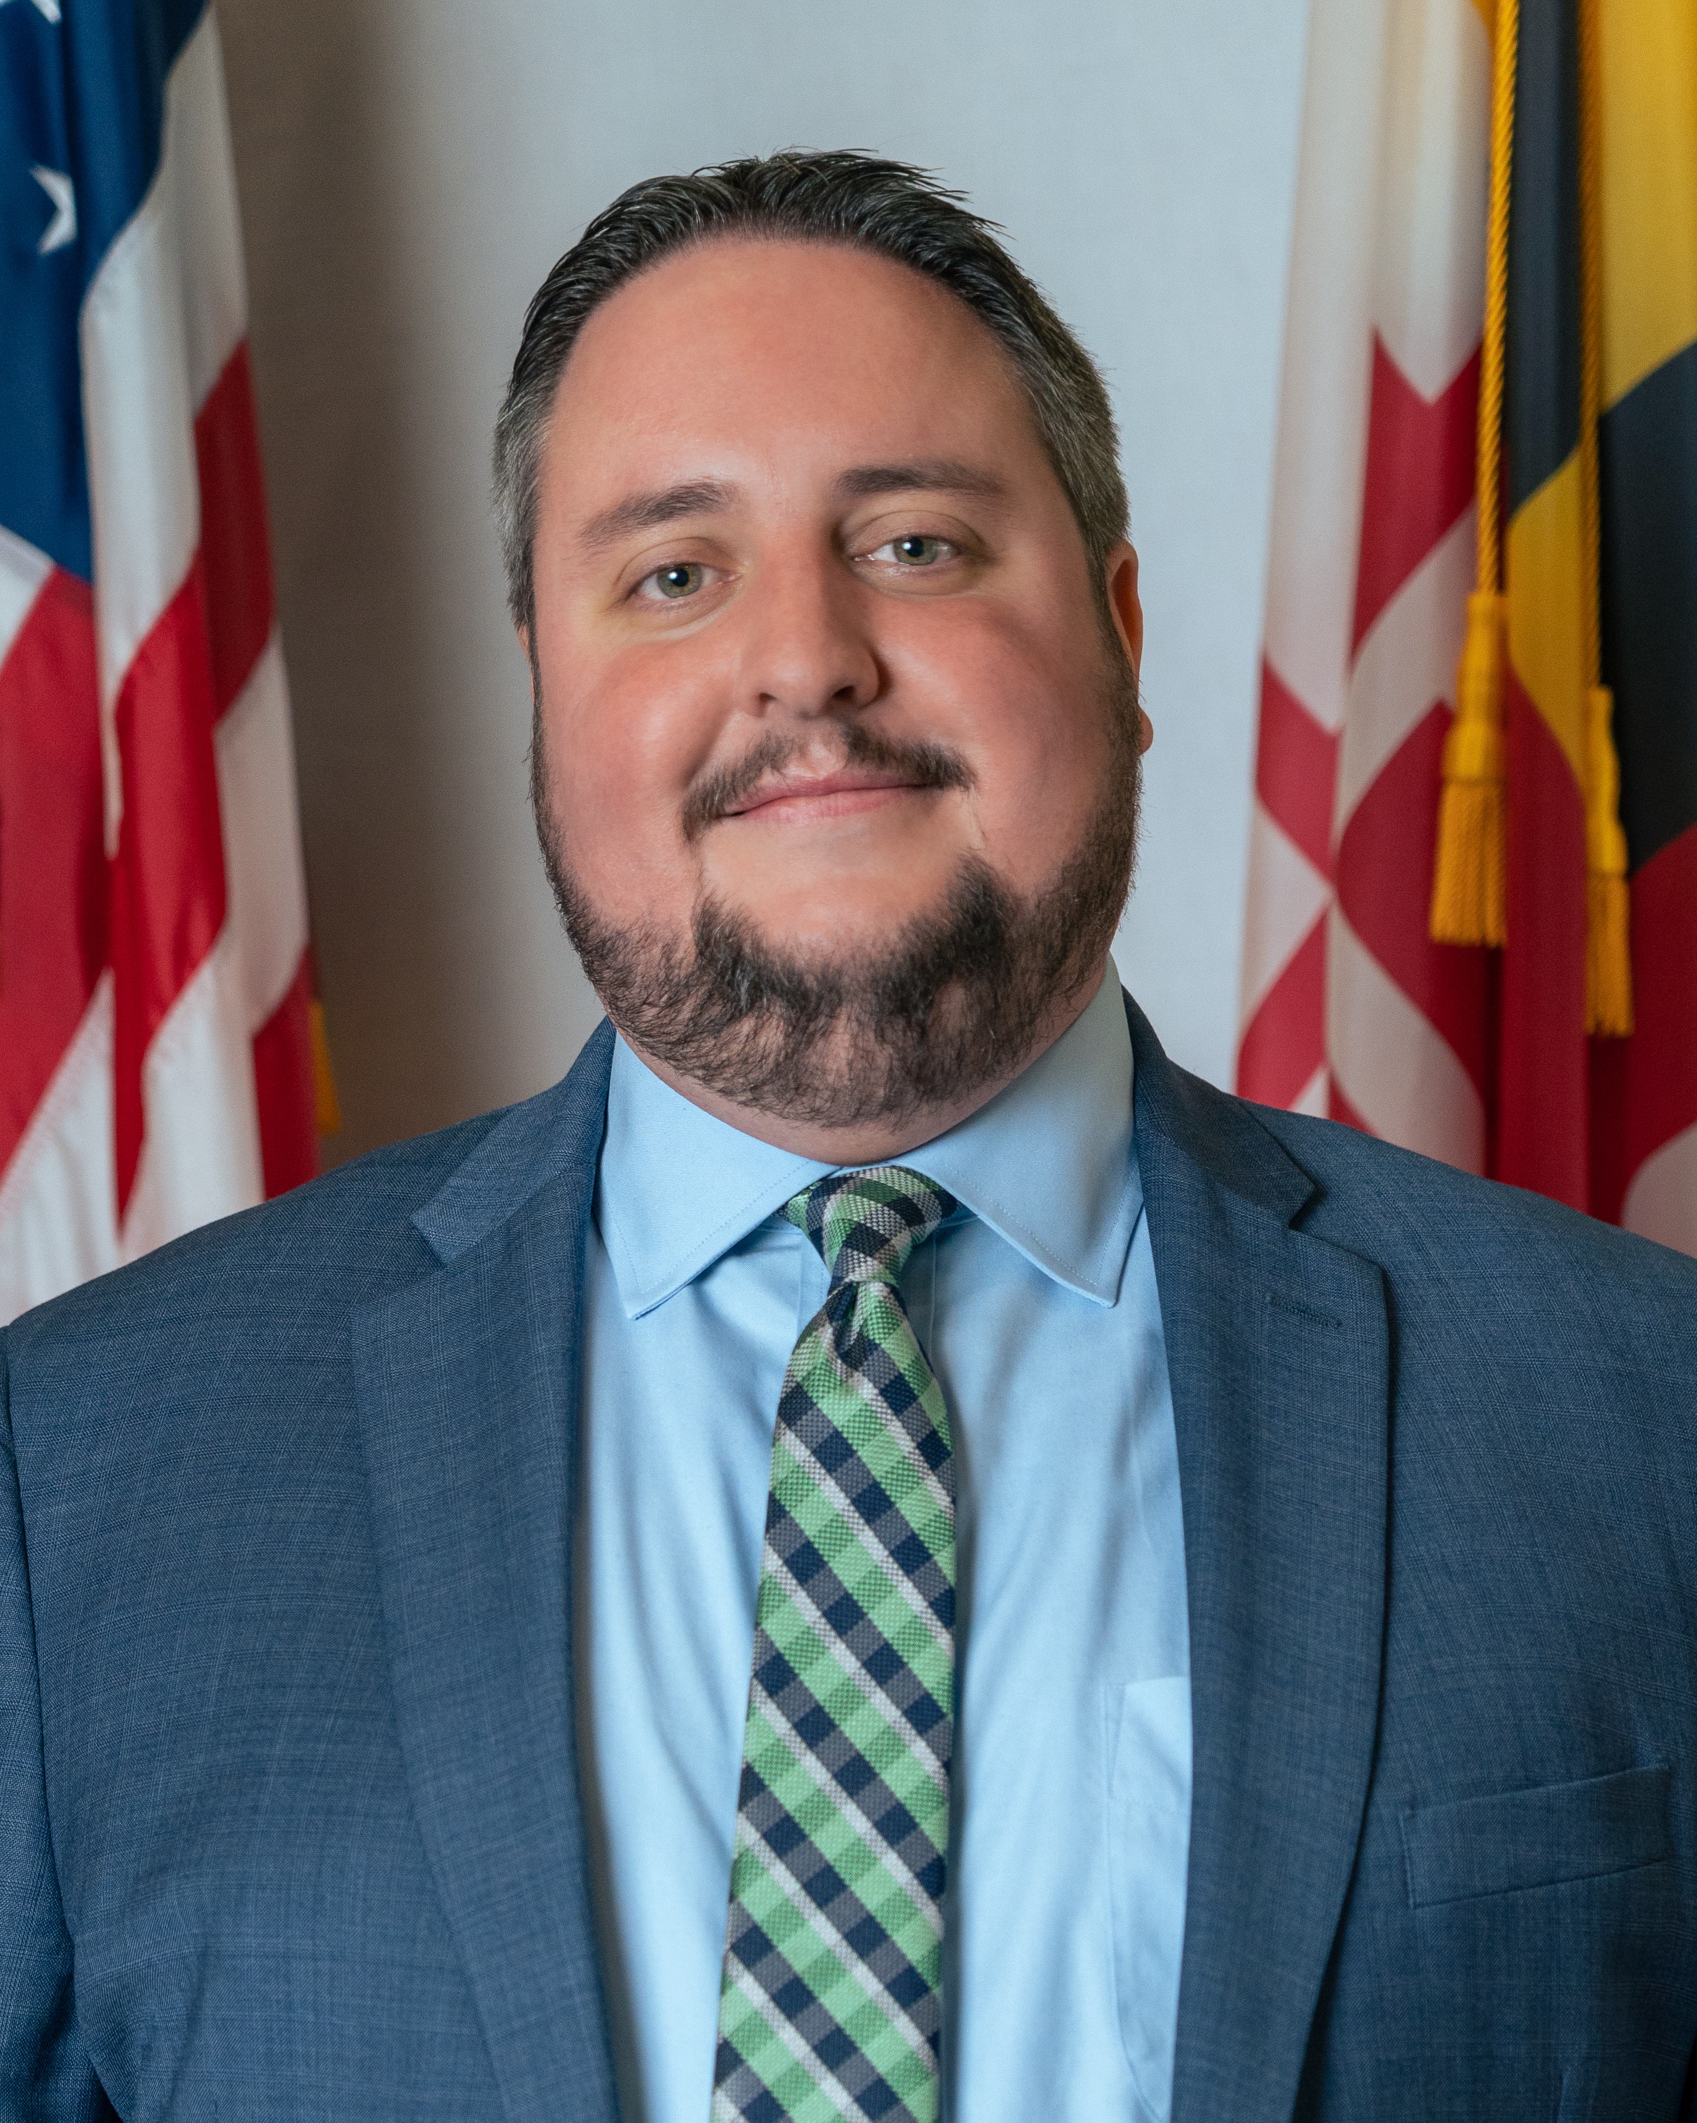
Alcohol, Tobacco, and Cannabis Commission
Jeffrey Hann
Assistant Director
Legal & Legislative Division

Slide 12
Questions?

Slide 13
January Webinar
January 10, 2024
1st day of session!
12:00-1:15

Slide 14
SAVE THE DATE
2024 Maryland Tobacco Conference
June 5, 2024
BWI Marriott

Slide 15

Thank You!

